Slide 1
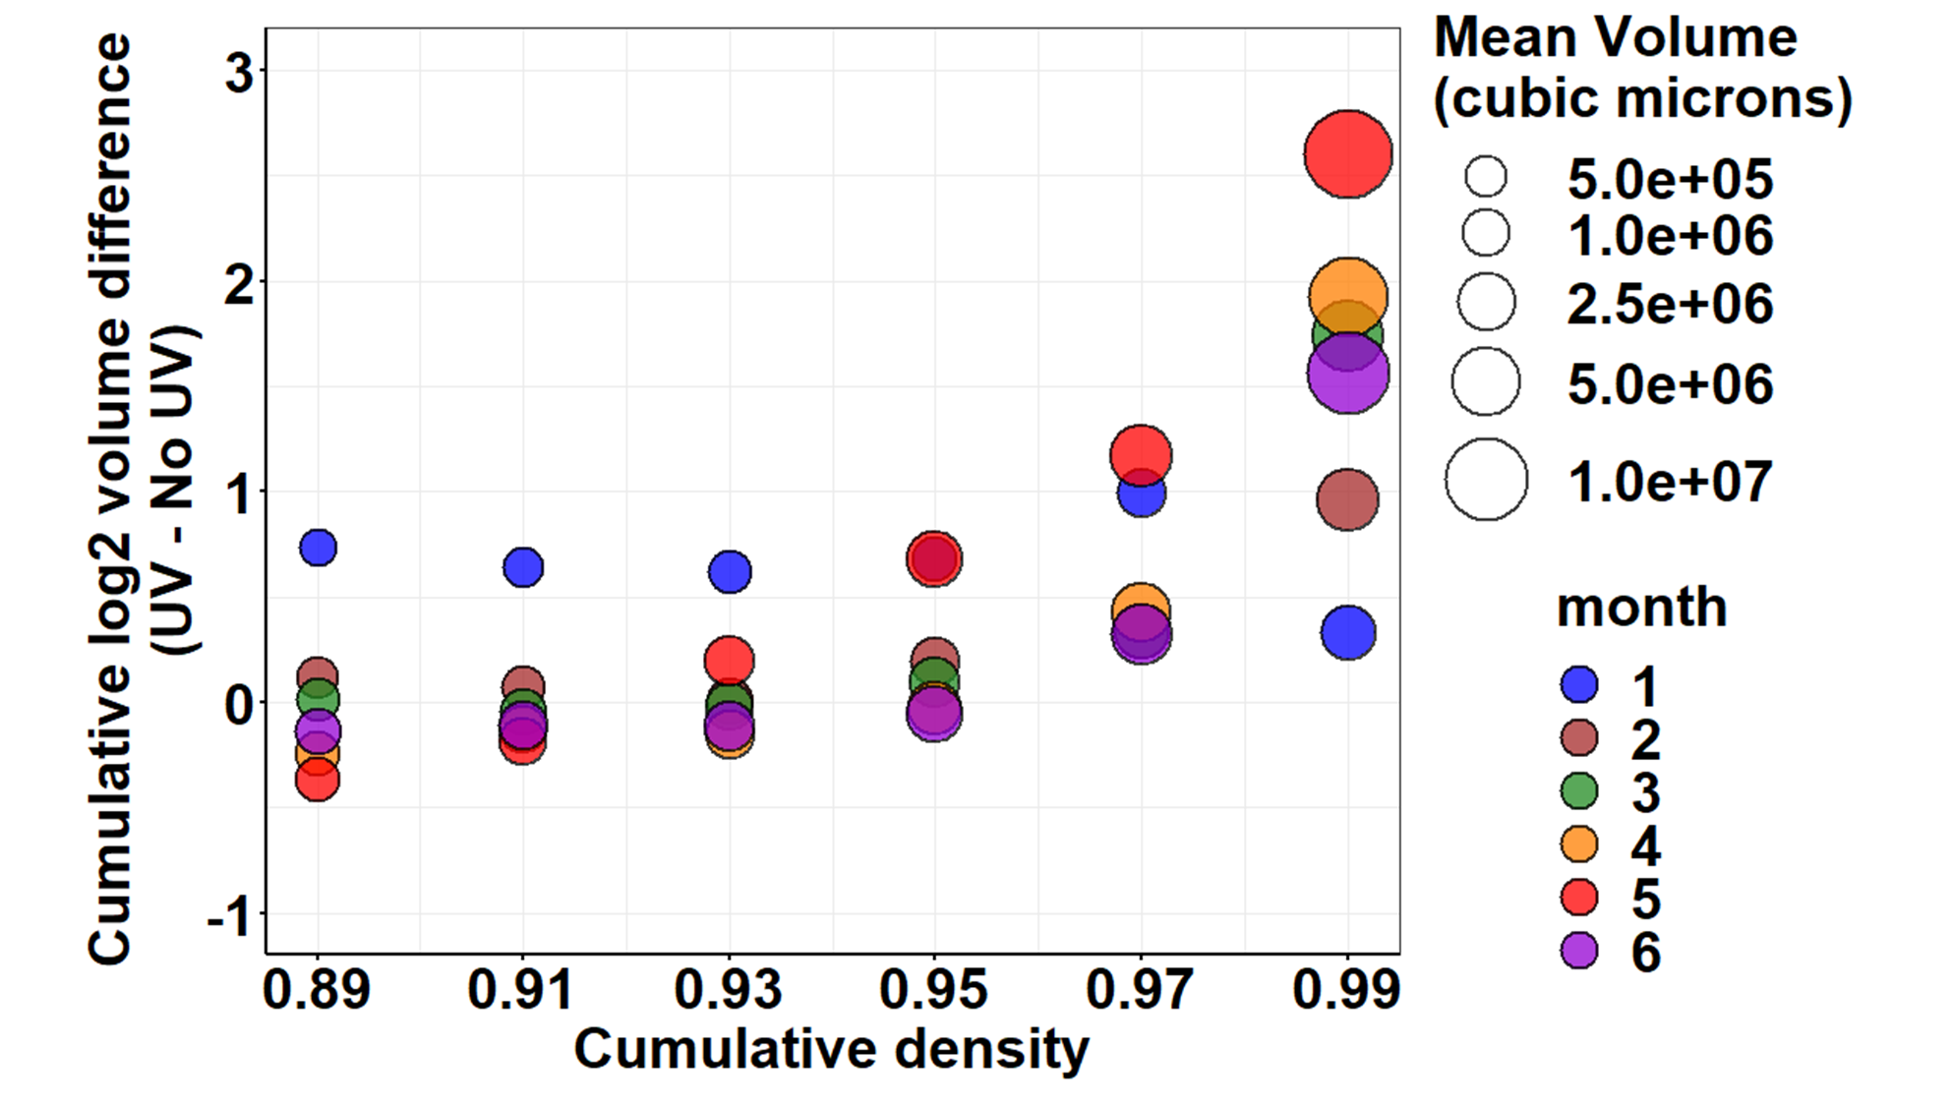
This is with corrected data

Slide 2
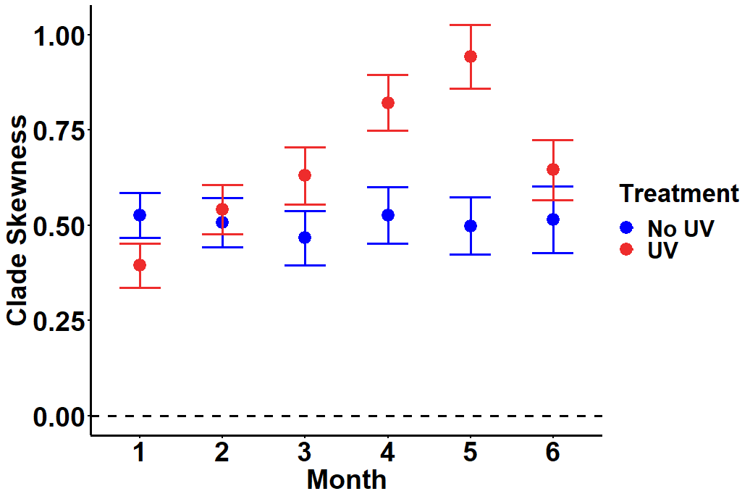
This is with corrected data

Slide 3
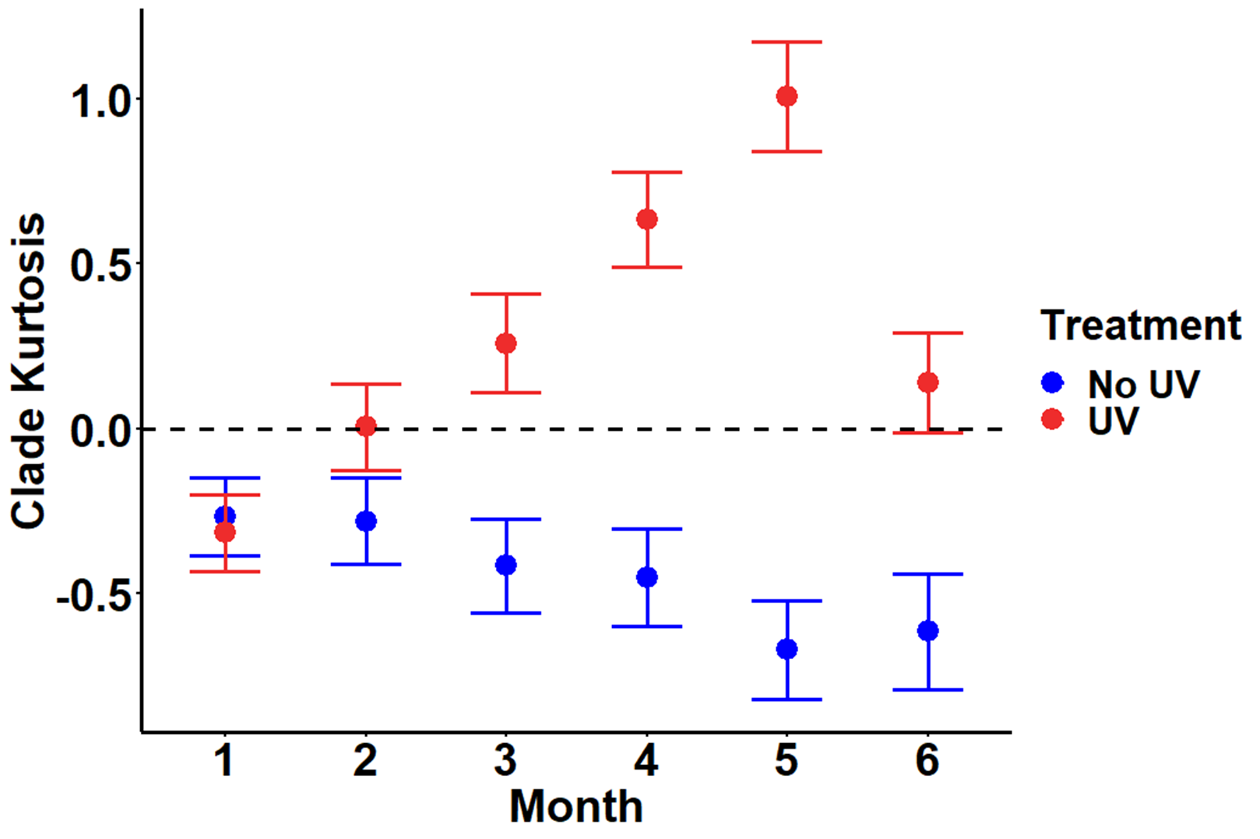
This is with corrected data

Slide 4
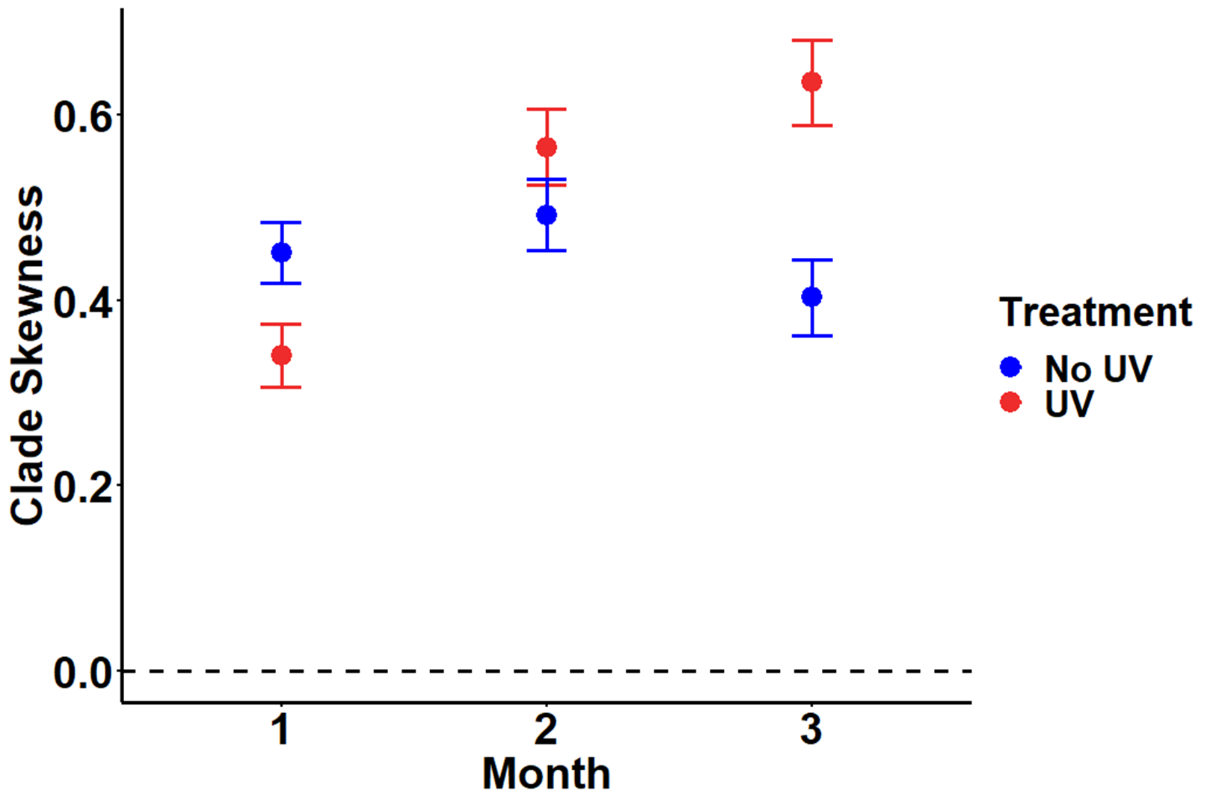
This is with corrected data

Slide 5
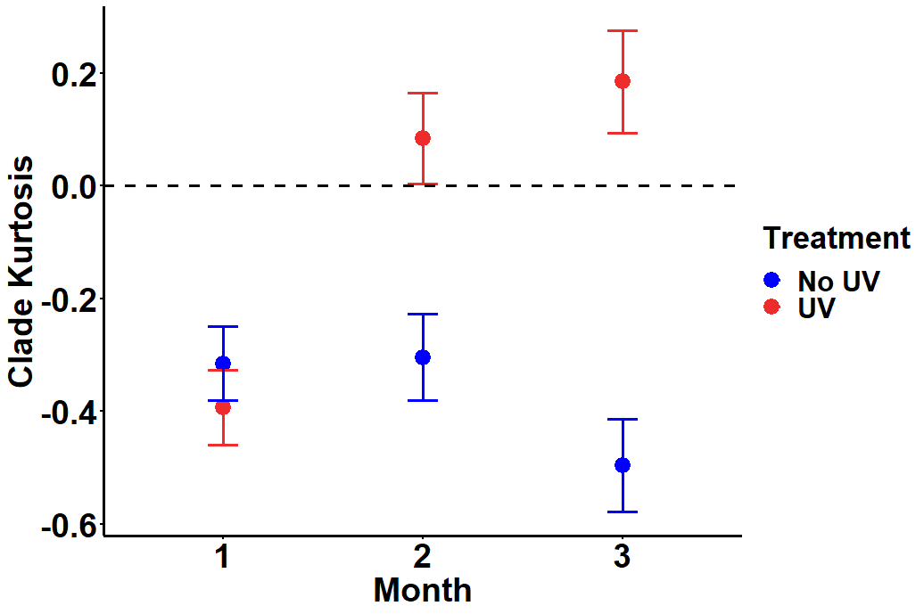
This is with corrected data

Slide 6
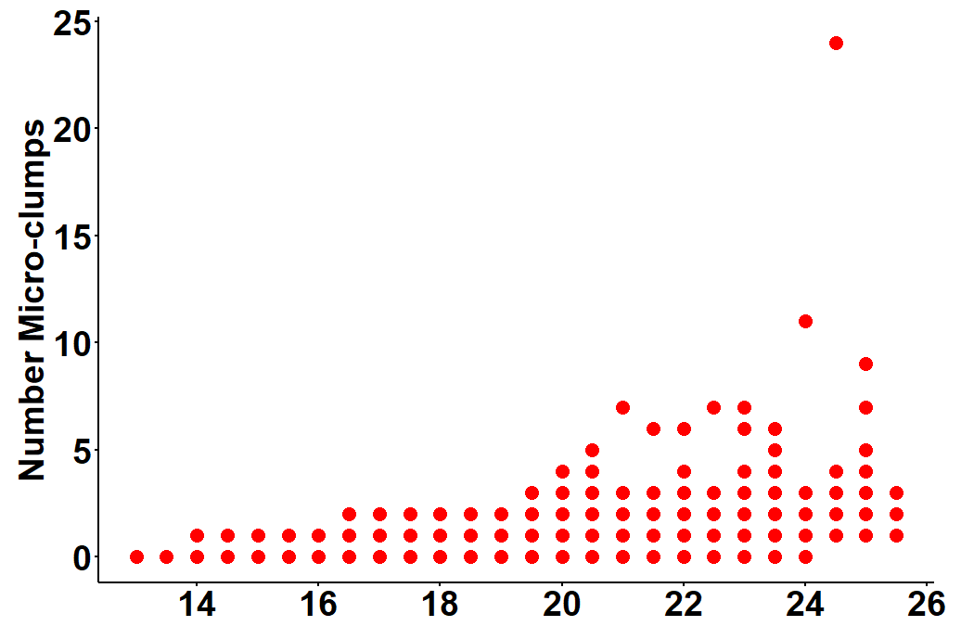
UV-treated
This is with corrected data
Clade volume (log₂(μm³))

Slide 7


Slide 8
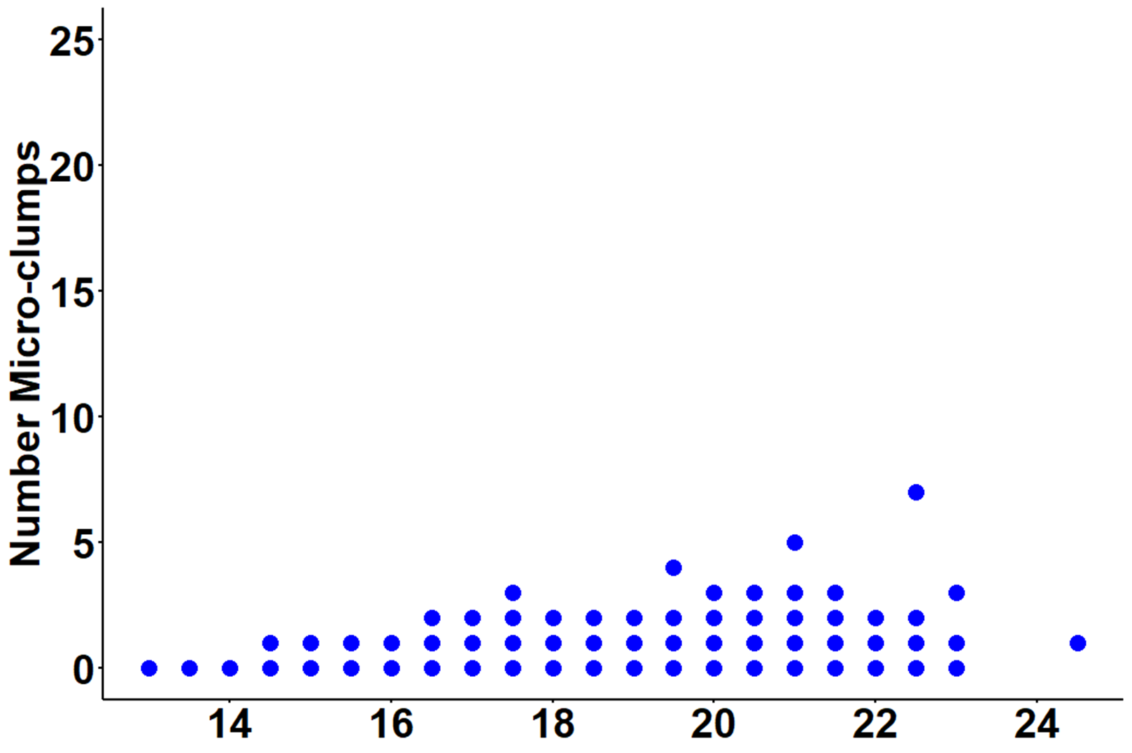
This is with corrected data
No-UV-treated
Clade volume (log₂(μm³))

Slide 10
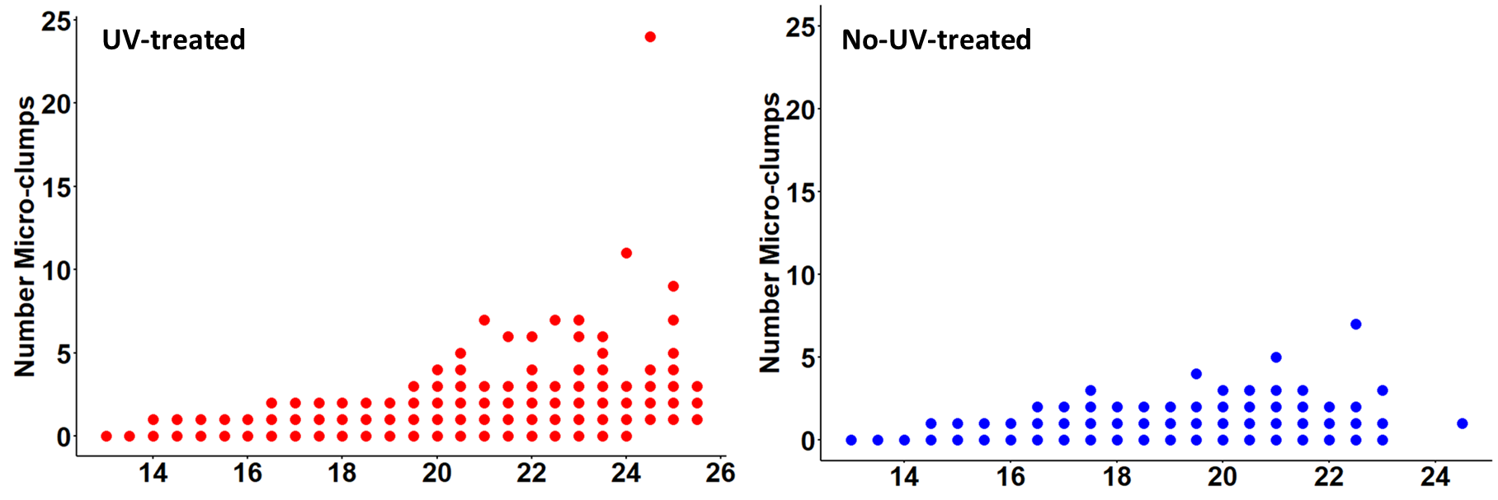
This is with corrected data (graph components combined)
Clade volume (log₂(μm³))

Slide 11


This is with corrected data (all figure components are separate
UV-treated
No-UV-treated
Clade volume (log₂(μm³))

Slide 12
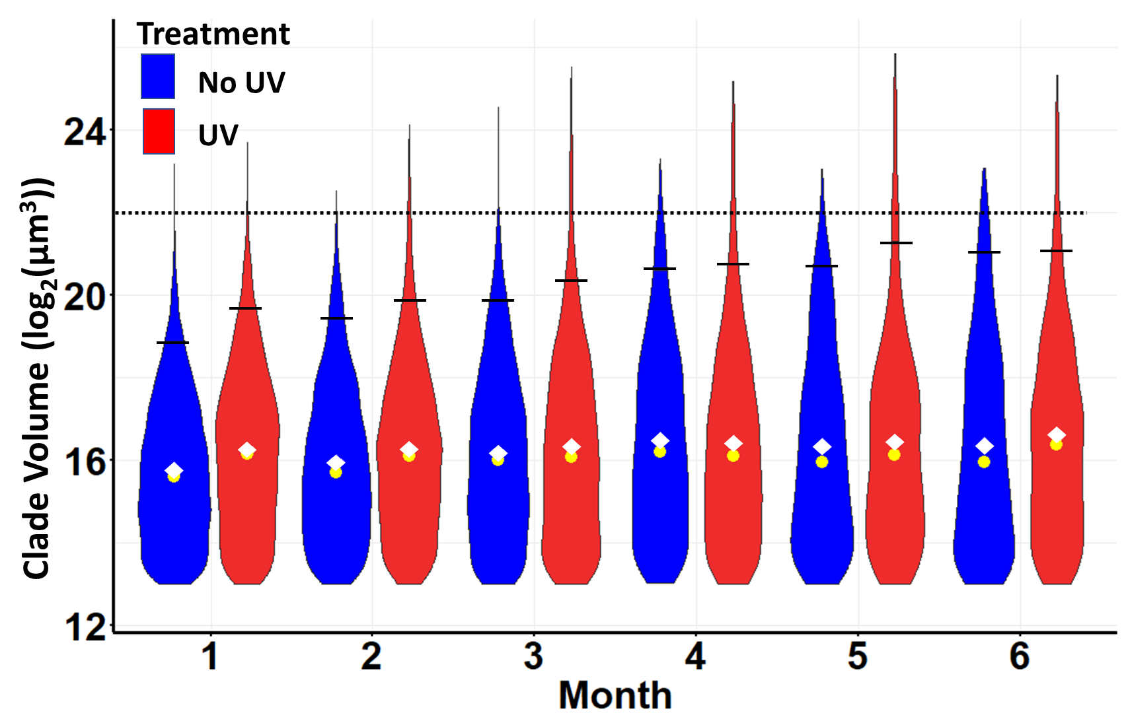

Slide 13
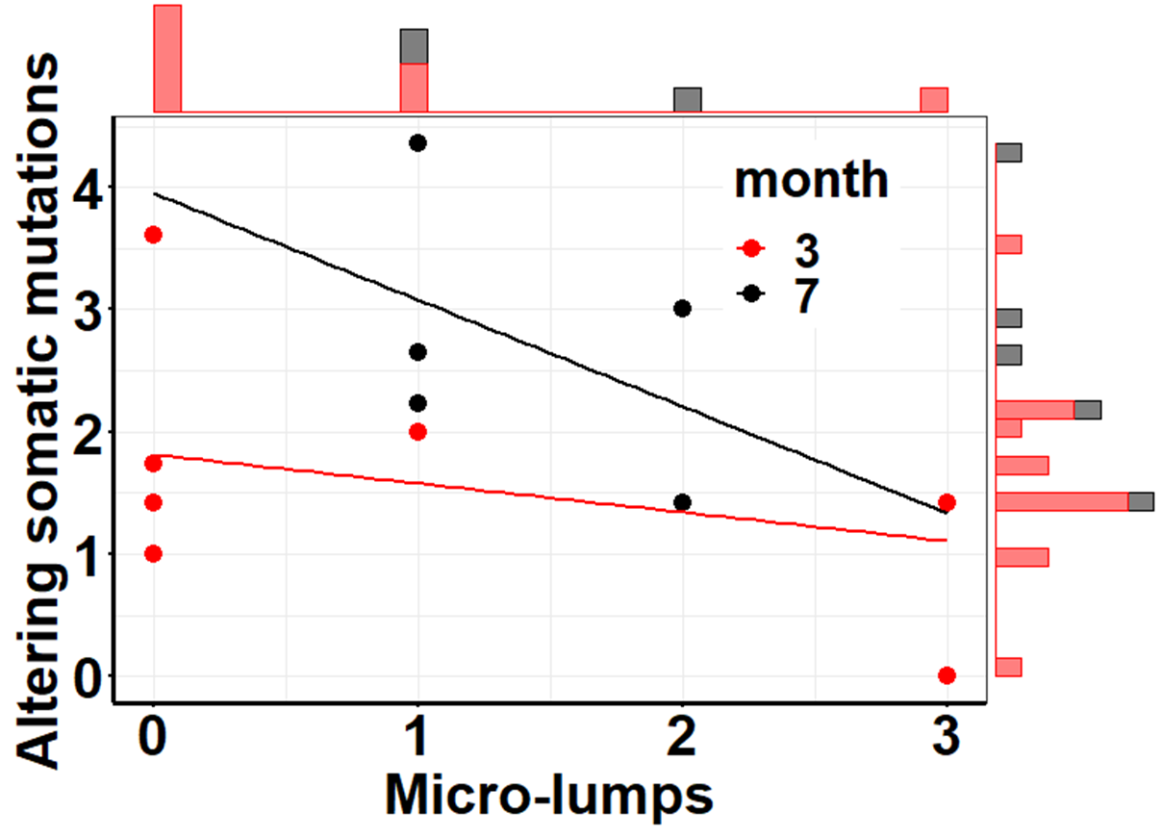
This is with correct data
No-UV-treated

Slide 14
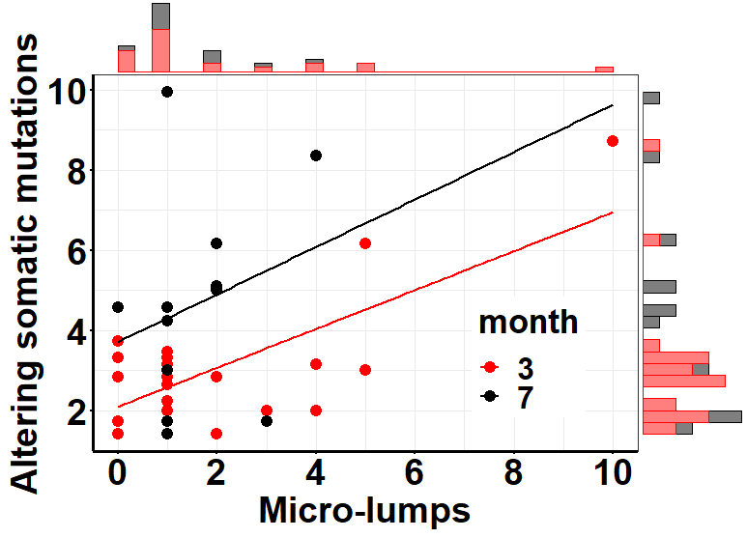
This is with correct data
UV-treated

Slide 15
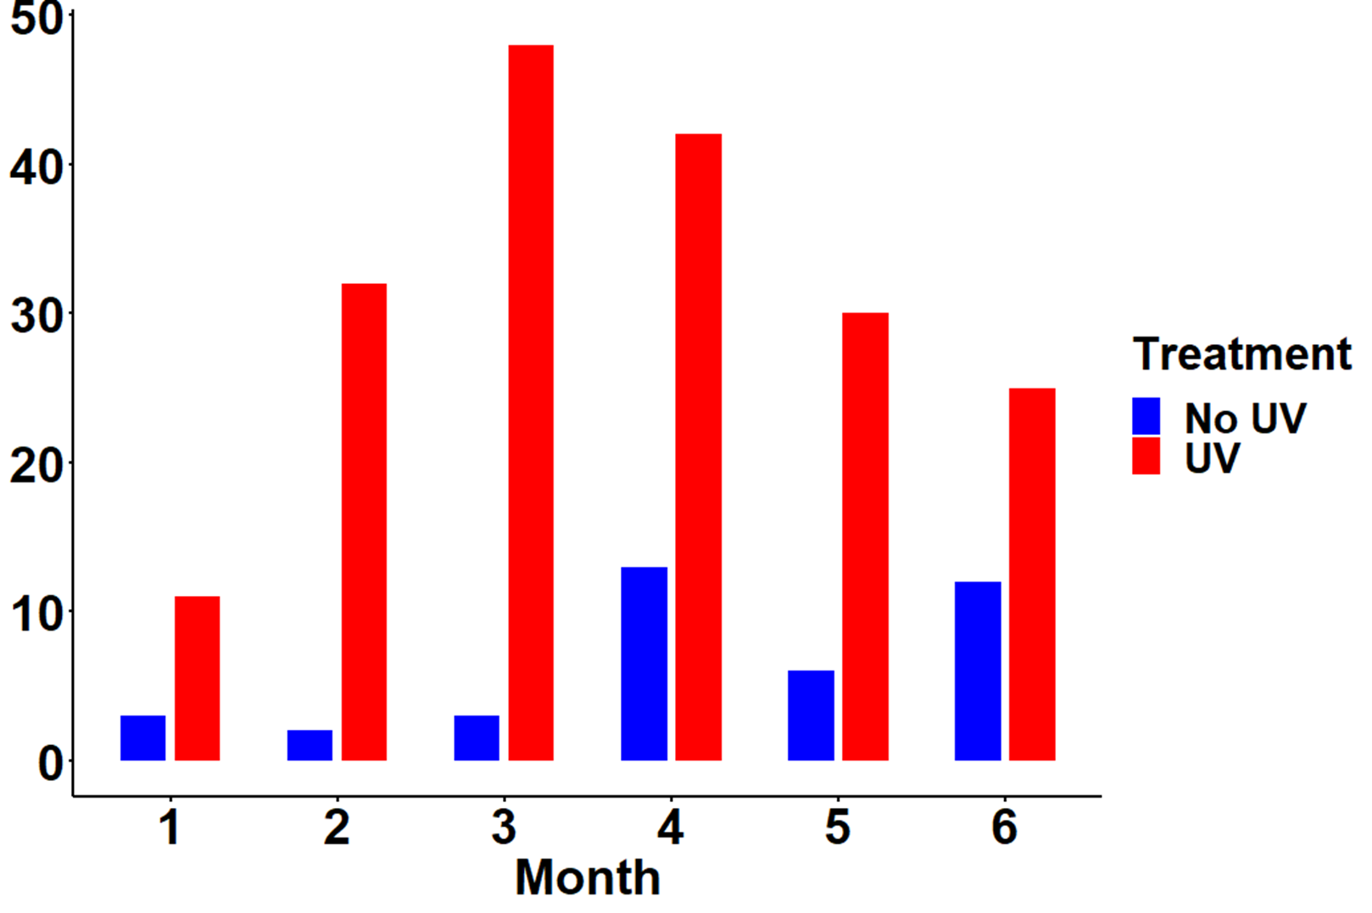
Number clades > 22 (log₂(μm³))

Slide 16
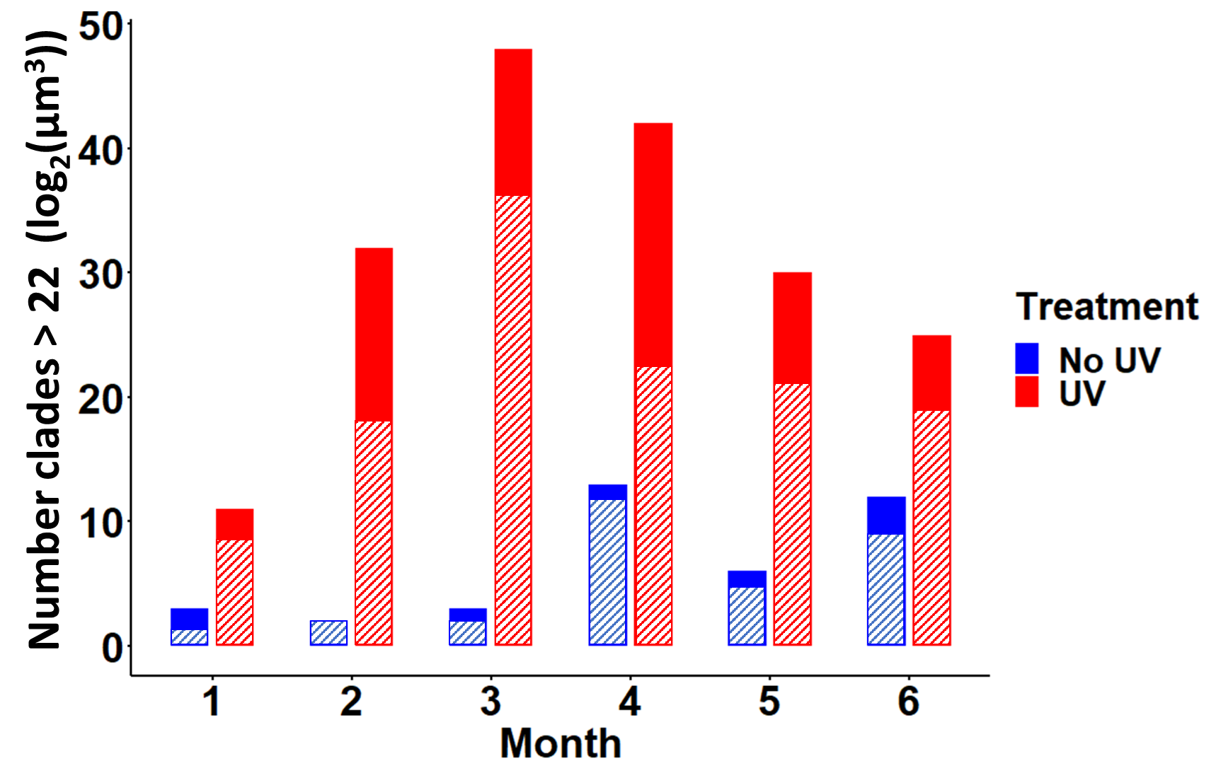

Slide 17
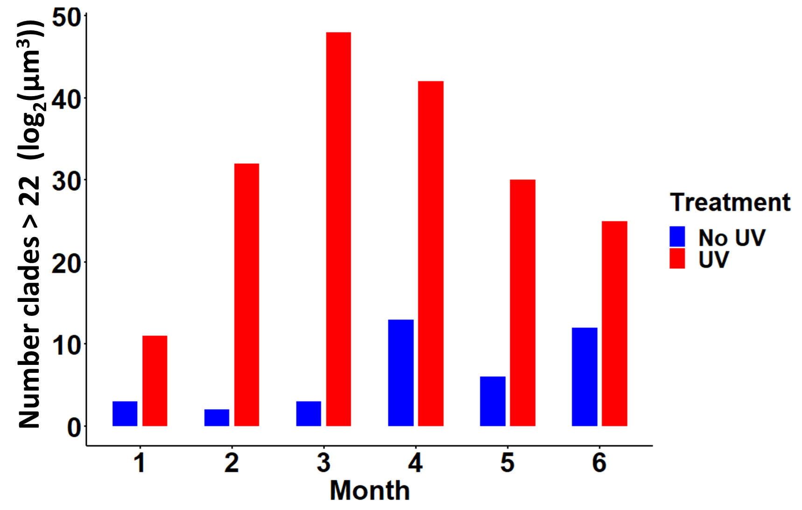

Slide 18
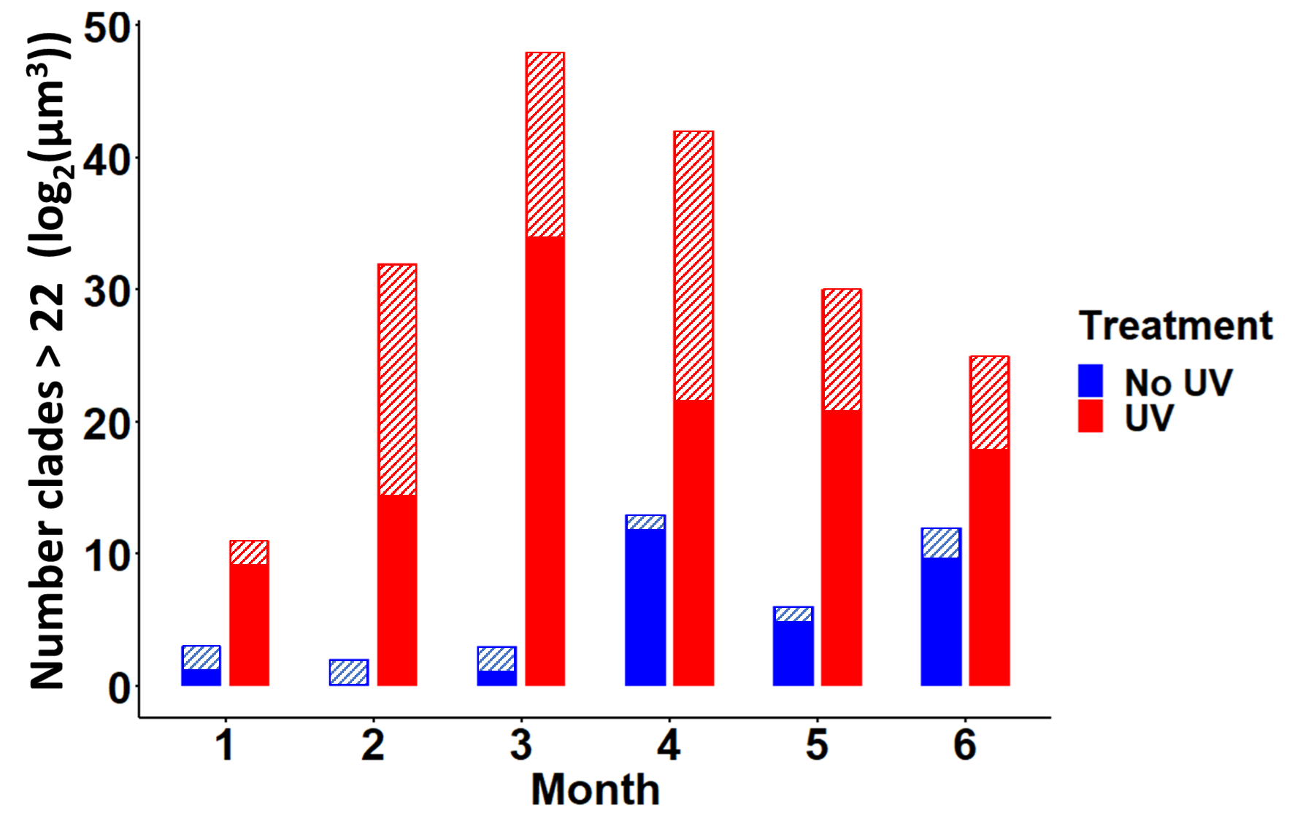

Slide 19
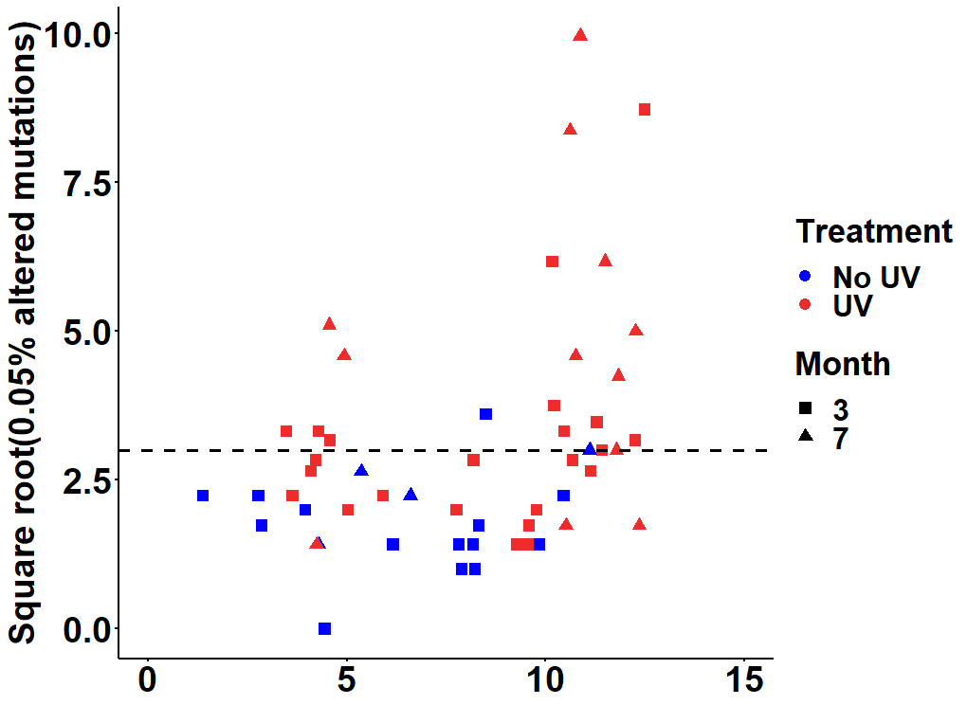

Slide 20
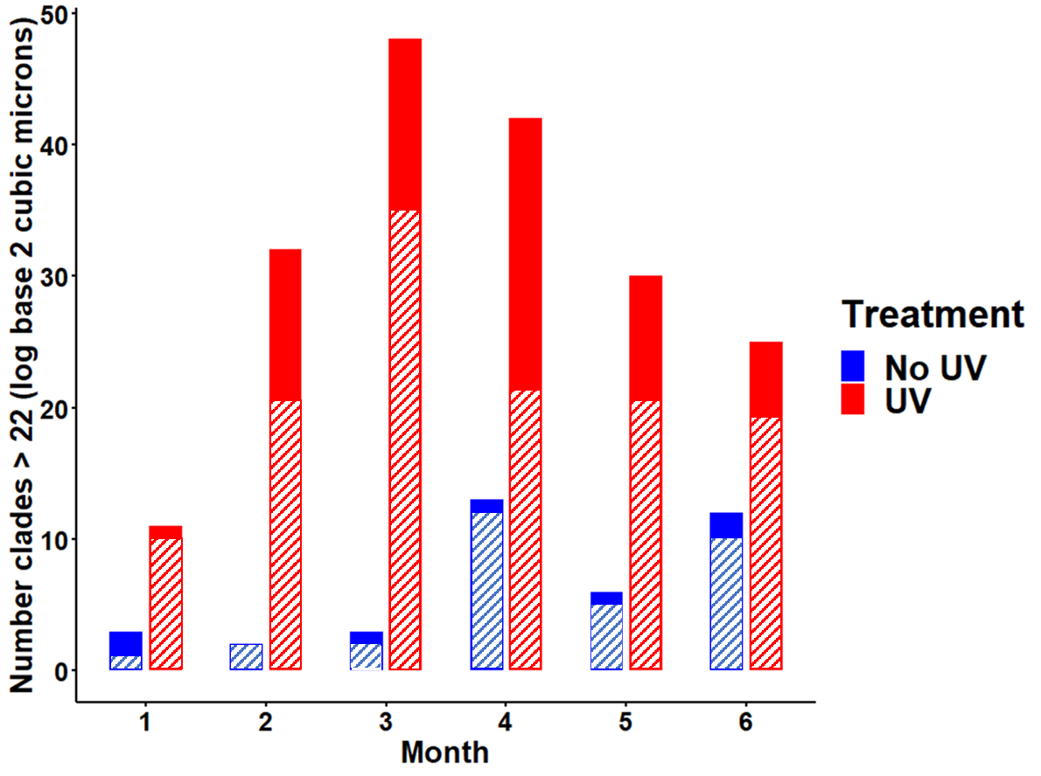

Slide 21
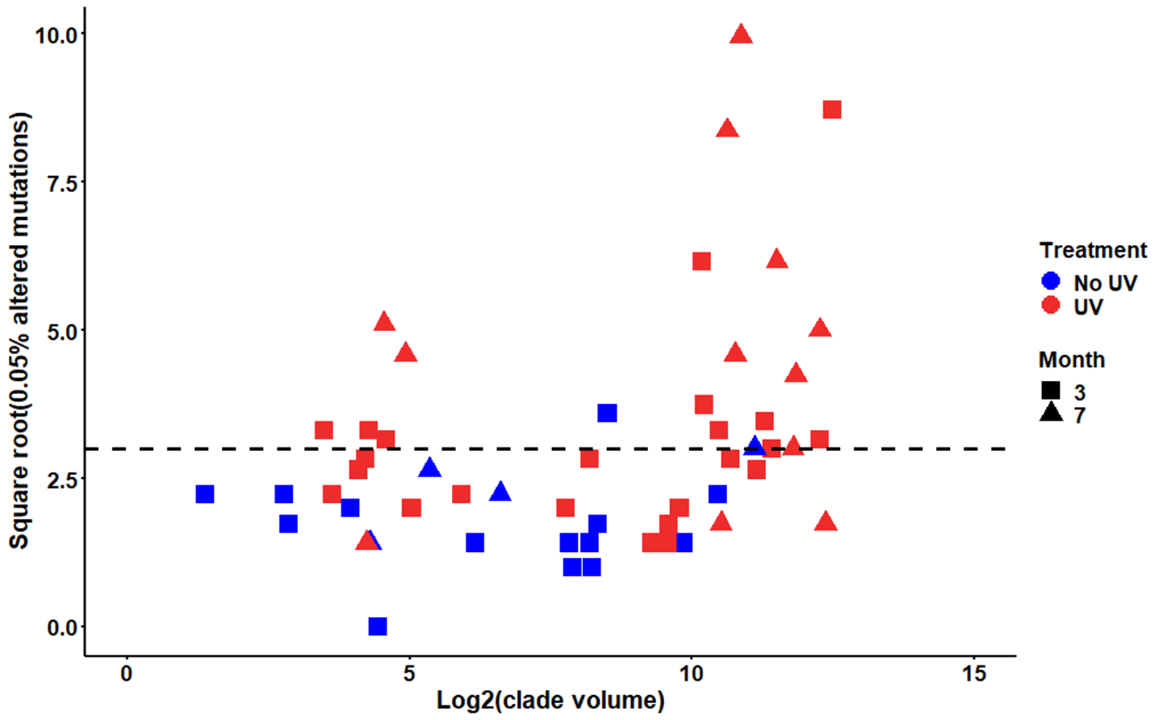
This is with correct data

Slide 22
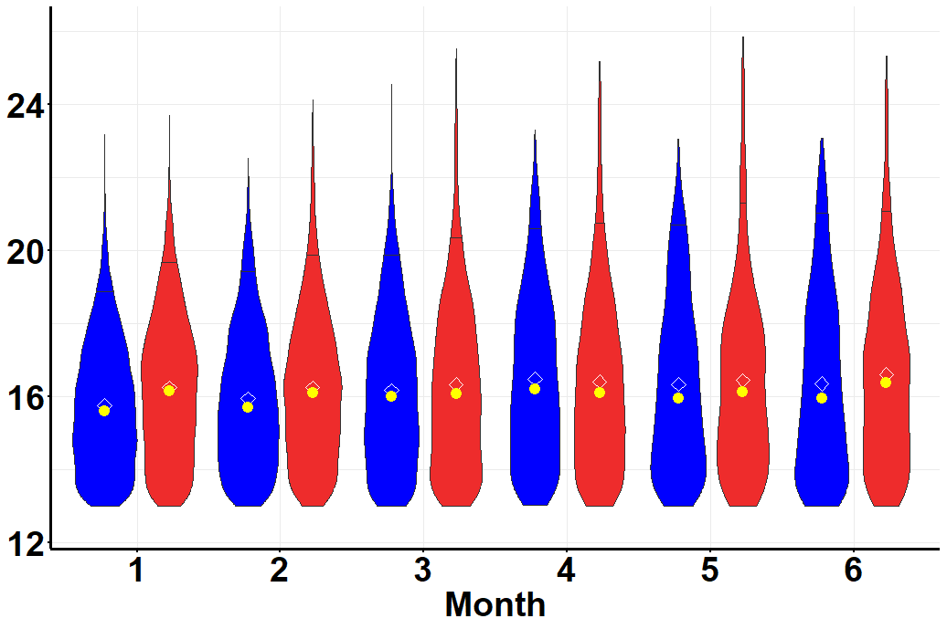
Treatment
No UV
UV
Clade Volume (log₂(μm³))

Slide 23
No UV
UV
Number clades > 22 (log₂(μm³))
Clade Volume (log₂(μm³))

Slide 24
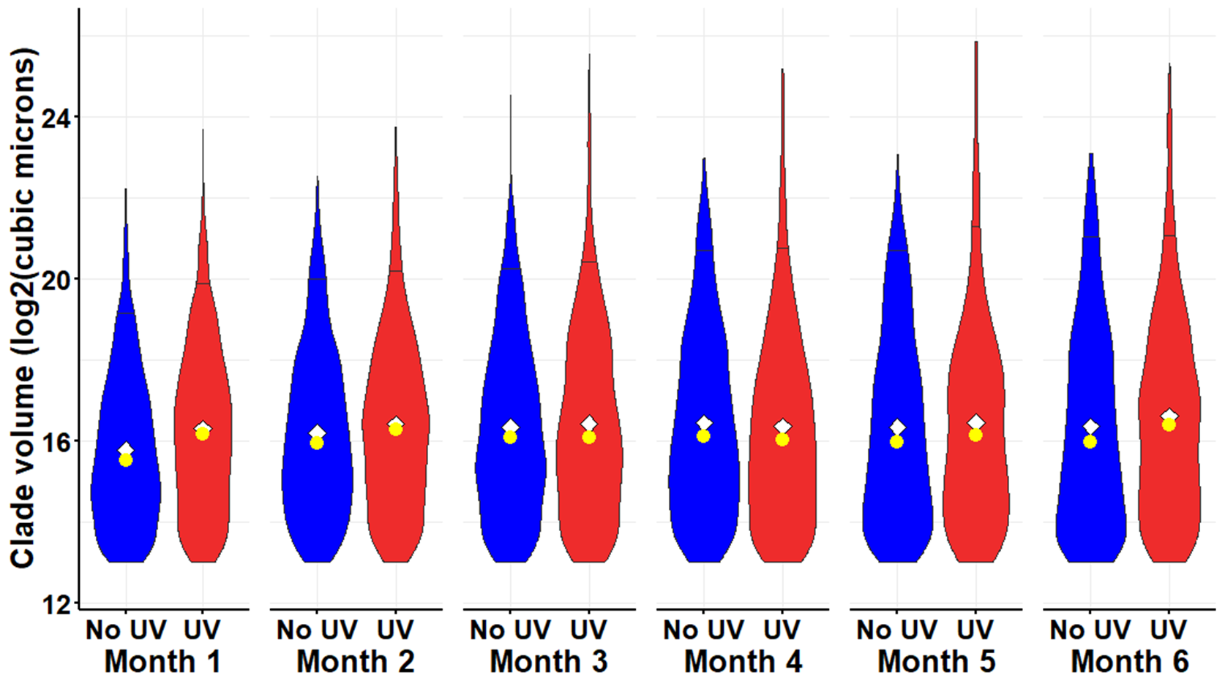
This is with corrected data

